Slide 1



Phases Of Compiler
Compiler operates in phases, each of which transforms the source pgm from one representation to another.
In practice , some of the phases may be grouped together.
Intermediate representation between the grouped phases need not be explicitly constructed.

Slide 2
Phases Of Compiler
Chapter 1
We basically have two phases of compilers, namely,
Analysis phase
Synthesis phase
Analysis:
Analysis phase creates an intermediate representation from the given source code.
Breaks up source pgm into constituent pieces.
Creates intermediate representation of source pgm.
Synthesis:
Synthesis phase creates an equivalent target program from the intermediate representation
Construct target pgm from intermediate representation.

Slide 3
A Language Processing System
Chapter 1
Preprocessor
Produce I/p to compiler. They may perform
Macro processing: shorthand for longer construct.
File inclusion: separate module can be used by including their file for example: #include <iostream>
Rational preprocessors: give support for additional facilities which are not included in compiler itself.
Language Extension: may include extra capabilities.

Slide 4
A Language Processing System
Chapter 1
Assembler
I/p from compiler in form of Assembly code.
Produce object file or relocatable m/c code
For example: loading can start at any location in memory.

Slide 5
A Language Processing System
Chapter 1
Loader/Linker Editor:
Performs 2 functions :
Loading:
Relocatable code is converted to absolute code i.e. placed at their specified position.
2. Link-Editor:
Make single pgm from several files of relocatable m/c code.
The file may be o/p of different compilation.
May be Library files or routine provided by system.
Result is executable file.

Slide 6
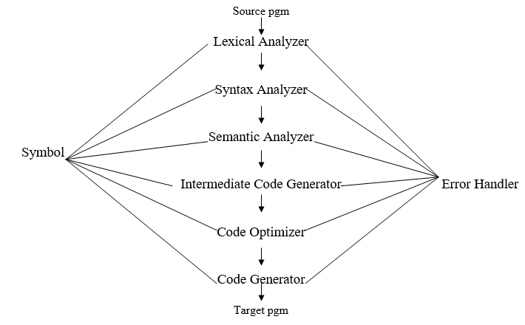
Phases Of Compiler
Chapter 1
Compiler operates in phases, each of which transforms the source pgm from one representation to another.

Slide 7
Analysis of a source program
Chapter 1
The analysis of a source program is divided into mainly three phases. They are:
Linear Analysis
Hierarchical Analysis
Semantic Analysis

Slide 8
Analysis of a source program
Chapter 1
Linear Analysis- This involves a scanning phase where the stream of characters are read from left to right. It is then then grouped into various tokens having a collective meaning.
Hierarchical Analysis- In this analysis phase, based on a collective meaning, the tokens are categorized hierarchically into nested groups.
Semantic Analysis- This phase is used to check whether the components of the source program are meaningful or not.

Slide 9
Two modules of Compiler
Chapter 1
The compiler has two modules namely front end and back end. Front-end constitutes of the Lexical analyzer, semantic analyzer, syntax analyzer and intermediate code generator. And the rest are assembled to form the back end.
Lexical Analyzer
Syntax Analyzer

Slide 10
Two modules of Compiler
Chapter 1
Lexical Analyzer
It is also called scanner.
It takes the output of preprocessor (which performs file inclusion and macro expansion) as the input which is in pure high level language.
It reads the characters from source program and groups them into lexemes (sequence of characters that “go together”).

Slide 11
Two modules of Compiler
Chapter 1
Lexical Analyzer
Each lexeme corresponds to a token.
Tokens are defined by regular expressions which are understood by the lexical analyzer.
It also removes lexical errors (for e.g., erroneous characters), comments and white space.

Slide 12
Two modules of Compiler
Chapter 1
Syntax Analyzer
It is sometimes called as parser. It constructs the parse tree. It takes all the tokens one by one and uses Context Free Grammar to construct the parse tree.
Why Grammar ? The rules of programming can be entirely represented in some few productions. Using these productions we can represent what the program actually is. The input has to be checked whether it is in the desired format or not.

Slide 13
Two modules of Compiler
Chapter 1
Syntax Analyzer
The parse tree is also called the derivation tree. Parse trees are generally constructed to check for ambiguity in the given grammar. There are certain rules associated with the derivation tree.
Any identifier is an expression.
Any number can be called an expression
Performing any operations in the given expression will always result in an expression. For example, the sum of two expressions is also an expression.
The parse tree can be compressed to form a syntax tree.
Syntax error can be detected at this level if the input is not in accordance with the grammar.

Slide 14
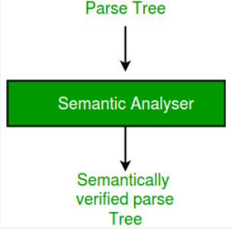
Two modules of Compiler
Chapter 1
Syntax Analyzer
Syntax error can be detected at this level if the input is not in accordance with the grammar.

Slide 15
Two modules of Compiler
Chapter 1
Semantic Analyzer
It verifies the parse tree, whether it’s meaningful or not. It furthermore produces a verified parse tree. It also does type checking, Label checking and Flow control checking.

Slide 16
Two modules of Compiler
Chapter 1
Intermediate Code Generator
It generates intermediate code, that is a form which can be readily executed by machine We have many popular intermediate codes. Example – Three address code etc. Intermediate code is converted to machine language using the last two phases which are platform dependent. Till intermediate code, it is same for every compiler out there, but after that, it depends on the platform. To build a new compiler we don’t need to build it from scratch. We can take the intermediate code from the already existing compiler and build the last two parts.

Slide 17
Two modules of Compiler
Chapter 1
Code Optimizer
It transforms the code so that it consumes fewer resources and produces more speed. The meaning of the code being transformed is not altered. Optimization can be categorized into two types: machine dependent and machine independent.

Slide 18
Two modules of Compiler
Chapter 1
Target Code Generator
The main purpose of Target Code generator is to write a code that the machine can understand and also register allocation, instruction selection etc. The output is dependent on the type of assembler. This is the final stage of compilation. The optimized code is converted into relocatable machine code which then forms the input to the linker and loader.

Slide 19
Chapter 1
Symbol Table Management
Symbol table is a data structure containing record for each identifier with fields for the attributes of the identifier.
This way compiler keeps track of identifiers used in source pgm.
Other phases also enters information into symbol table and uses these records.

Slide 20
Chapter 1
Error Detection & Reporting
It is used by all phases when error is encountered.
after detecting error , it must be dealt with in order to allow compilation to proceed.

Slide 21
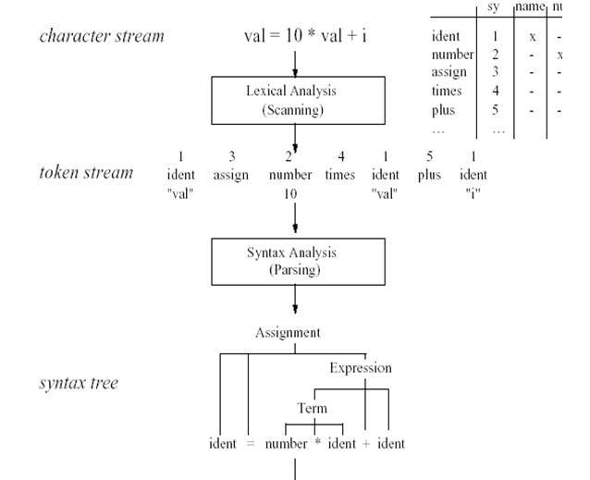
Chapter 1
Dynamic Structure of a Compiler

Slide 22
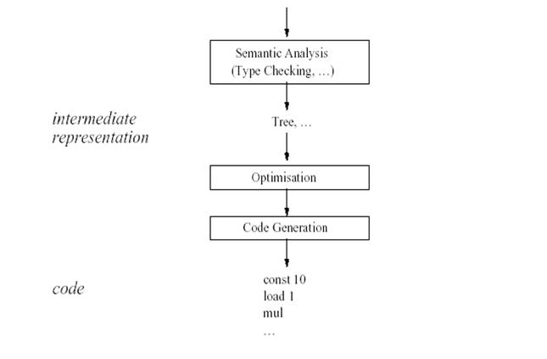
Chapter 1
Dynamic Structure of a Compiler

Slide 23
Chapter 1
Lexical Analyzer
Reads character/ group of characters called Lexeme in the source pgm and groups them into a stream of tokens
Lexeme: set of string
It can be
Keyword or reserve word
Identifier (procedure/functions name, variable name)
Operator( Arithmetic, Conditional, Logical, Assignment, punctuation symbol, lateral string, Numbers)
Lexical Analyzer ignores comments or white spaces

Slide 24
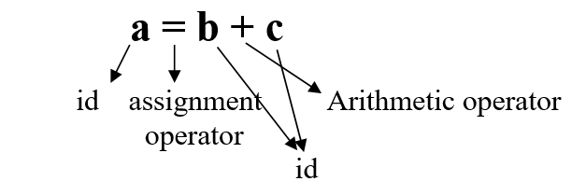
Chapter 1
Lexical Analyzer
Lexical Analyzer ignores comments or white spaces
For Example:

Slide 25
Chapter 1
Lexical Analyzer
Token:
For each lexeme , Lexical Analyzer generates a token. So lexical analyzer converts source pgm to token file each representing a lexeme.
Errors are captured by lexical analyzer during scanning of lexeme.
Each lexeme has a specific structure and error is reported if that structure is not present
For Example: If 1234.a is a lexeme,
Lexical will generate error as after decimal point number should come.

Slide 26
Chapter 1
Syntax Analyzer
Check that the tokens from lexical analyzer are placed according to construct or language rules.
Apply Hierarchal structure on token stream.
Different methods are applied to check the correct placement of token in stream.
.

Slide 27
Chapter 1
Syntax Analyzer
Check that the tokens from lexical analyzer are placed according to construct or language rules.
Apply Hierarchal structure on token stream.
Different methods are applied to check the correct placement of token in stream.
.

Slide 28
Chapter 1
Semantic Analyzer
Analyzes meaning of each statement in pgm.
Gives o/p in form of parse tree.
It will detect all possible logical errors like type mismatch or out of scope variable.

Slide 29
Chapter 1
Intermediate Code Generator
Generate a pgm for an abstract m/c.
Intermediate representation should be easy to produce.
It should be easy to translate into target pgm.
Also called some times 3-address code which is like assembly language for a m/c in which every memory location acts like register.

Slide 30
Chapter 1
Intermediate Code Generator
For Example: a = b + c * d / f
Intermediate code for above example:
T1 = c * d
T2 = T1 / f
T3 = b + T2
A = T3
* can also be in some other format

Slide 31
Chapter 1
Code Optimizer
Improves intermediate code so that faster running m/c code results
It decreases the redundancy in code
E.g. a = a * 1
E.g. x = x + 0
Increases speed by removing redundancy
E.g. x = y ^ 2 → x = y * y

Slide 32
Chapter 1
Code Optimizer
Similarly,
Temp1 = intToReal (60)
Temp2 = id3 * Temp1
Temp3 = id2 + Temp2
id1 = Temp3
→ Temp1 = id3 * 60.0
id1 = id2 + Temp1

Slide 33
Chapter 1
Code Generator
Target code is generated
Analysis Model of Compilation
Includes 1st 3 phases
Synthesis Model of Compilation
Includes last 3 phases

Slide 34
Chapter 1
Other Tools that Use the Analysis-Synthesis Model
• Editors (syntax highlighting)
• Pretty printers (e.g. Doxygen)
• Static checkers (e.g. Lint and Splint)
• Interpreters
• Text formatters (e.g. TeX and LaTeX)
• Silicon compilers (e.g. VHDL)
• Query interpreters/compilers (Databases)

Slide 35
Chapter 1
Structure Editors
A structure editor takes as input a sequence of commands to build a source program.
The structure editor not only performs the text creation and modification functions of an ordinary text editor but it also analyzes the program text, putting an appropriate hierarchical structure on the source program.
Thus the structure editor can perform additional tasks that are useful in the preparation of programs.

Slide 36
Chapter 1
Structure Editors
A structure editor takes as input a sequence of commands to build a source program.
The structure editor not only performs the text creation and modification functions of an ordinary text editor but it also analyzes the program text, putting an appropriate hierarchical structure on the source program.
Thus the structure editor can perform additional tasks that are useful in the preparation of programs.
For example, it can check that the input is correctly formed, can supply key words automatically

Slide 37
Chapter 1
Pretty printers
A pretty printer analyzes a program and prints it in such a way that the structure of the program becomes clearly visible.
For example comments may appear in a special font, and the statements may appear with an amount of indentation proportional to the depth of their nesting in the hierarchical organization of the statement.

Slide 38
Chapter 1
Static Checkers
• A static checker reads a program, analyzes it, and attempts to discover potential bugs without running the program.
• A static checker may detect that parts of the source program can never be executed, or that a certain variable might be used before being defined.
• In addition, it can catch logical errors such as trying to use a real variable as a pointer, employing the type checking techniques.

Slide 39
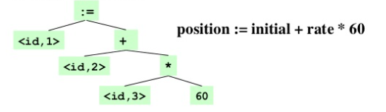
Chapter 1
Interpreters
Instead of producing a target program as a translation, an interpreter performs the operations implied by the source program.
For example, for an assignment statement an interpreter might build a tree and then carry out the operations at the nodes as it “walks” the tree.

Slide 40
Chapter 1
Interpreters
Instead of producing a target program as a translation, an interpreter performs the operations implied by the source program.
For example, for an assignment statement an interpreter might build a tree and then carry out the operations at the nodes as it “walks” the tree.

Slide 41
Chapter 1
Interpreters
At the root it would discover it had an assignment to perform, so it would call a routine to evaluate the expression on the right, and then store the resulting value in the location associated with the identifier position.
At the right child of the root, the routine would discover it had to compute the sum of two expressions
It would call itself recursively to compute the value of expression rate * 60
It would then add that value to the value of the variable initial

Slide 42
Chapter 1
Text Formatters
A text formatter takes input that is a stream of characters, most of which is text to be typeset, but some of which includes commands to indicate paragraphs, figures or mathematical structures like subscripts and superscripts.

Slide 43
Chapter 1
Silicon compilers
• A silicon compiler has a source language that is similar or identical to a conventional programming language.
• However, the variables of the language represent, not locations in memory but logical signals (0 or 1) or groups of signals in a switching circuit.

Slide 44
Chapter 1
Query interpreters
A query interpreter translates a predicate containing relational and Boolean operators into commands to search a database for records satisfying that predicate.

Slide 45
Chapter 1
Summary
Compiler operates in various phases each phase transforms the source program from one representation to another
Six phases of compiler design are 1) Lexical analysis 2) Syntax analysis 3) Semantic analysis 4) Intermediate code generator 5) Code optimizer 6) Code Generator
Lexical Analysis is the first phase when compiler scans the source code
Syntax analysis is all about discovering structure in text
Semantic analysis checks the semantic consistency of the code
Once the semantic analysis phase is over the compiler, generate intermediate code for the target machine
Code optimization phase removes unnecessary code line and arranges the sequence of statements
Code generation phase gets inputs from code optimization phase and produces the page code or object code as a result
A symbol table contains a record for each identifier with fields for the attributes of the identifier
Error handling routine handles error and reports during many phases

Slide 46
Chapter 1
Thank You

